Slide 1

Capstone Project
Shop For Home
By
Snehal Hubale
Mohammad Shaik Neelufar
Thota Pushpalatha
M Gaganasri
Vaibhav Gupta
JAVA+GCP C2
Group – G11

Slide 2
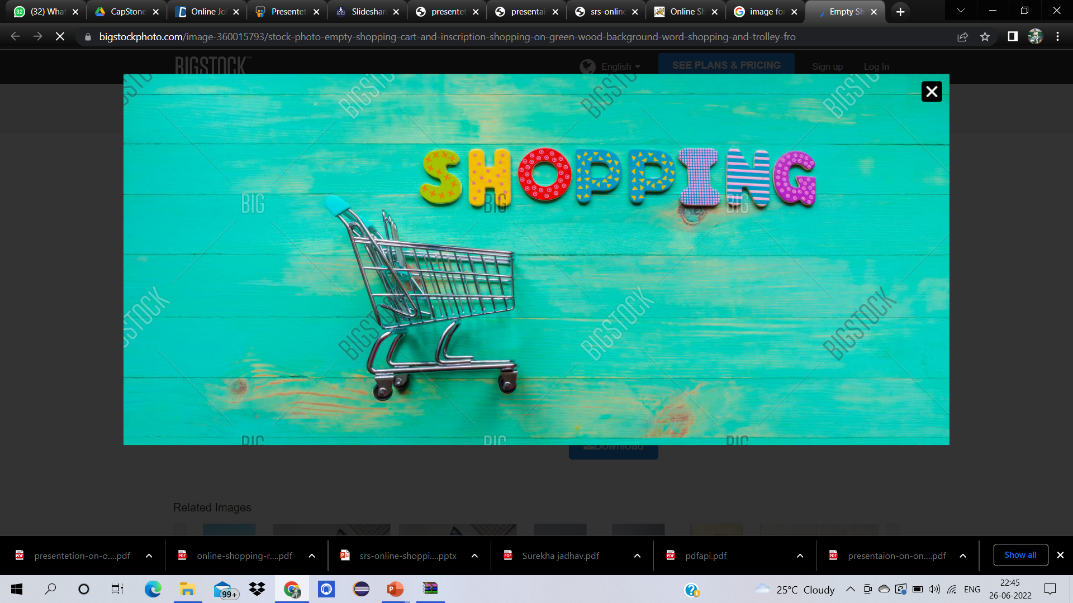
Project objective
The objective of the project is to make an application in android platform to purchase items in an existing shop. In order to build such an application complete web support need to be provided.

Slide 3
introduction
Shop For Home is a web application for shopping the home decor stuff such as dinning tavles,hanging light ,croceries and other home decoration are available
Online shops give us the opportunity to shop 24/7, and also reward us with a ‘no pollution’ shopping experience
reducing phone calls about availability, specifications, hours of operation or other information easily found on company and product pages

Slide 4
TECHNOLOGIES AND TOOLS USED
TECHNOLOGIES:
Front-End: HTML, CSS, JAVASCRIPT, BOOTSTRAP, ANGULAR 8
Back-End: SPRINGBOOT
TOOLS:
Front-End: Visual Studio Code
Back-End: STS4(Spring Tool Suite 4), PostgreSQL
Browser: Google Chrome For Development

Slide 5
modules
The system after careful analysis has been identified to be presented with the following modules and roles. The modules involved are:
➢ Administrator
➢ Moderators
➢ Users
ADMINISTRATOR: The administrator is the super user of this application. Only admin have access into this admin page. Admin may be the owner of the shop. The administrator has all the information about all the users and about all products.
This module is divided into different sub-modules.
Manage Moderators 4. Manage Orders
Manage Products
Manage Users

Slide 6
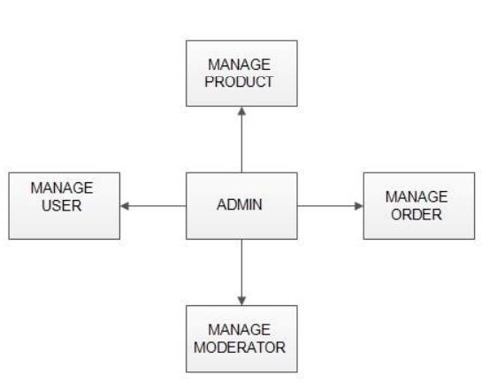
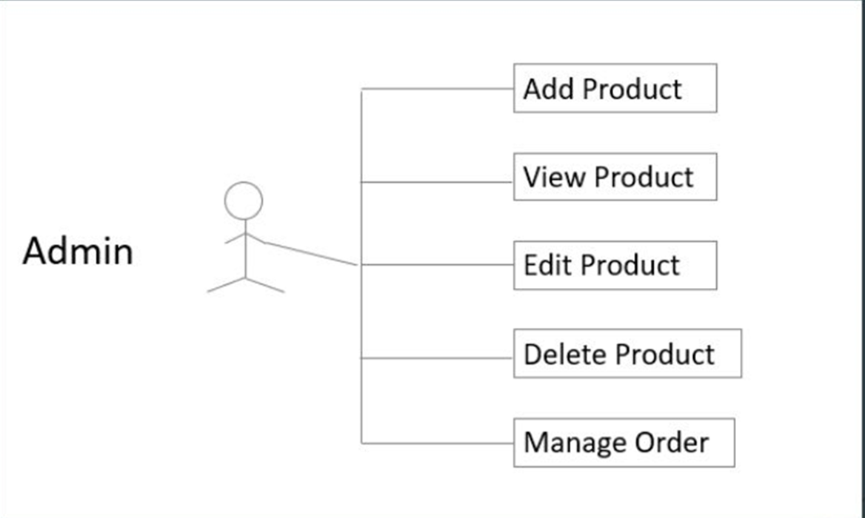
Fig : Admin module
Fig : User case diagram for admin

Slide 7
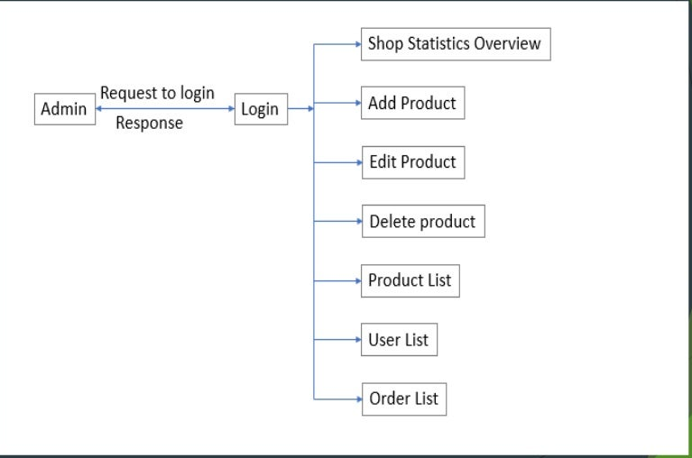
DATA FLOW DIAGRAM FOR ADMIN

Slide 8
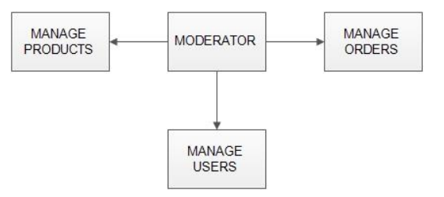
MODERATORS: A moderator is considered as a staff who can manage orders for the time being. As a future update moderator may give facility to add and manage his own products. Moderators can reduce the work load of admin. Now moderator has all the privilege an admin having except managing other moderators. He can add products and users. He can also check the orders and edit his profile.
➢ Manage products
➢ Manage users
➢ Manage orders
Fig : Moderator Module

Slide 9
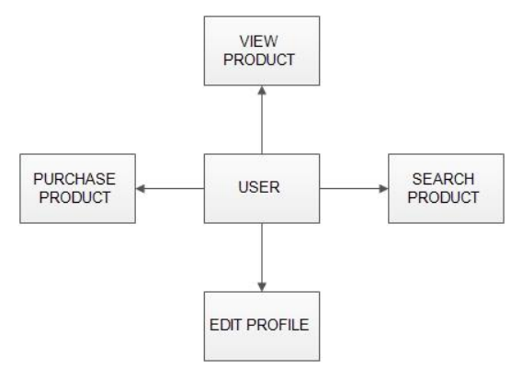
USERS
Fig : User Module
Registration : A new user will have to register in the system by providing essential details in order to view the products in the system. The admin must accept a new user by unblocking him.
Login : A user must login with his user name and password to the system after registration.

Slide 10
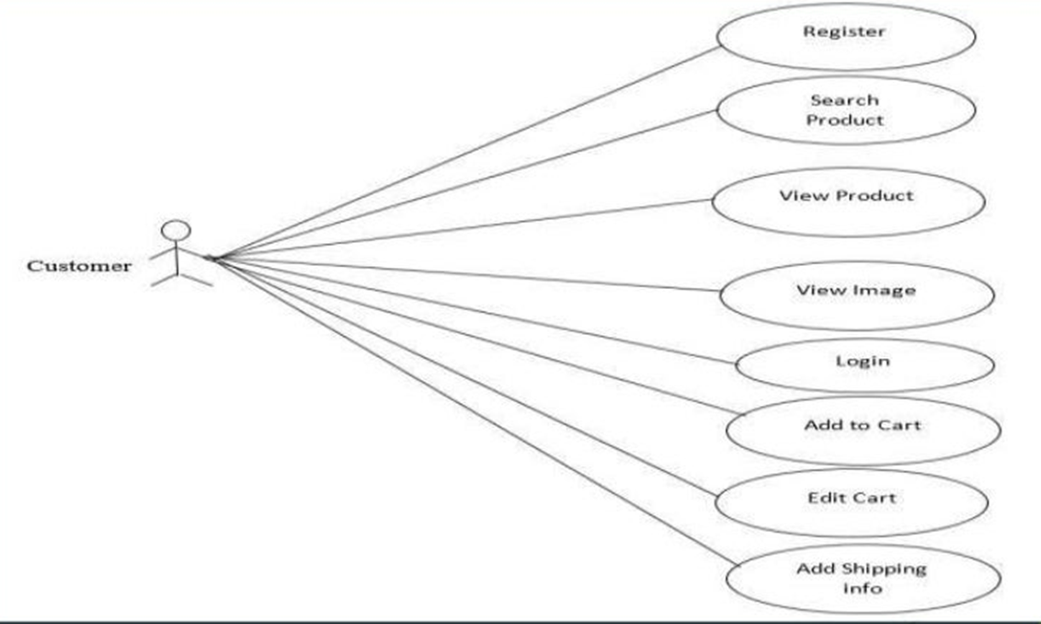
User case diagram for customer

Slide 11
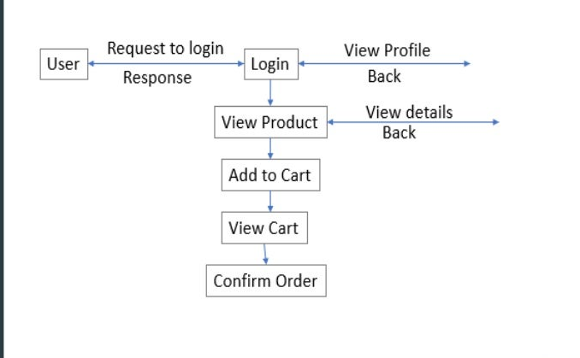
DATA FLOW DIAGRAM FOR USER LOGIN

Slide 12
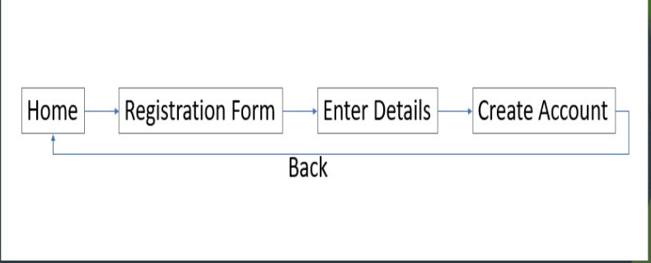
DATA FLOW DIAGRAM FOR ACCOUNT CREATION

Slide 13
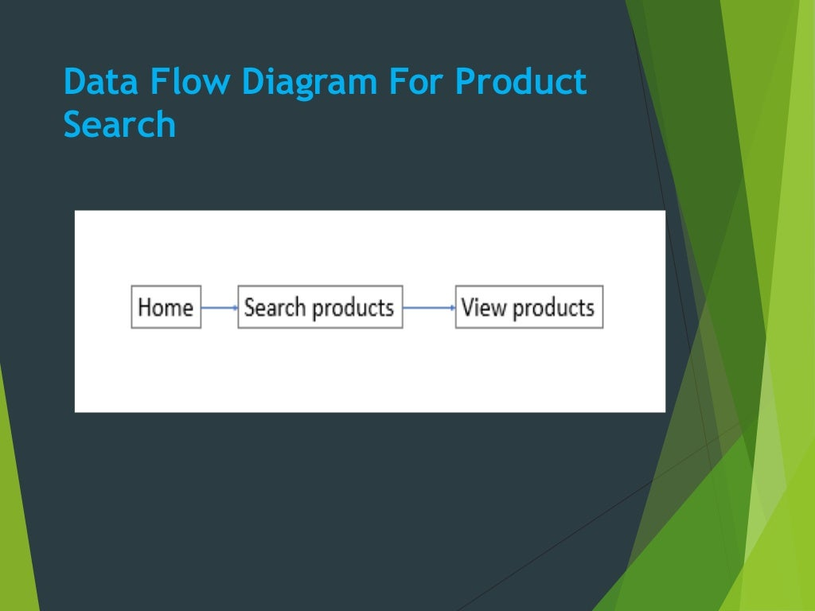
DATA FLOW DIAGRAM FOR PRODUCT SEARCH

Slide 14
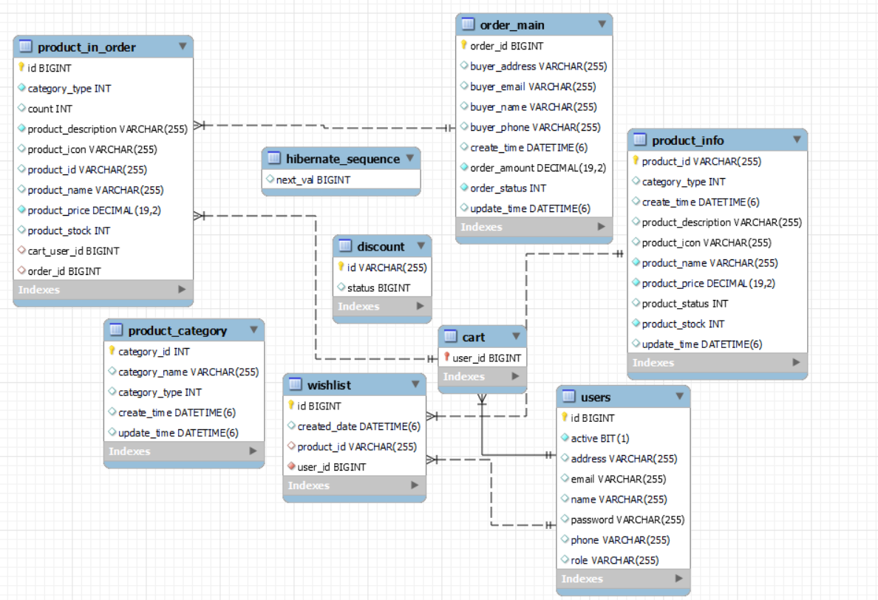
DATABASE SCHEMA

Slide 15
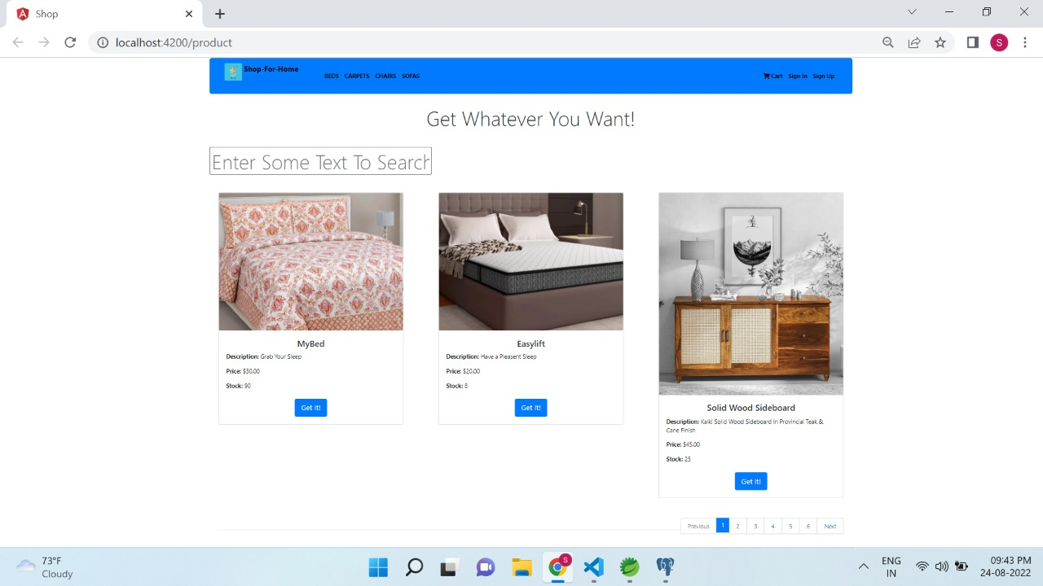
HOME PAGE(Shop For Home)

Slide 16
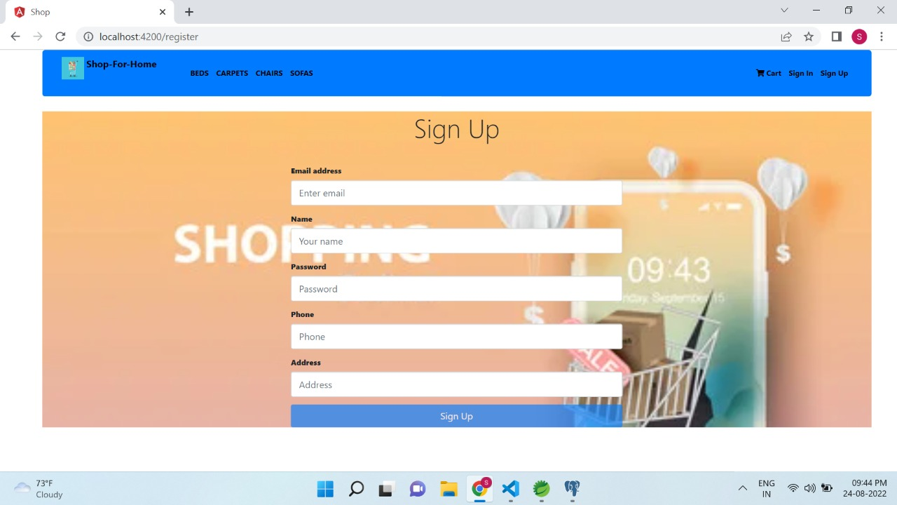
SIGN UP

Slide 17
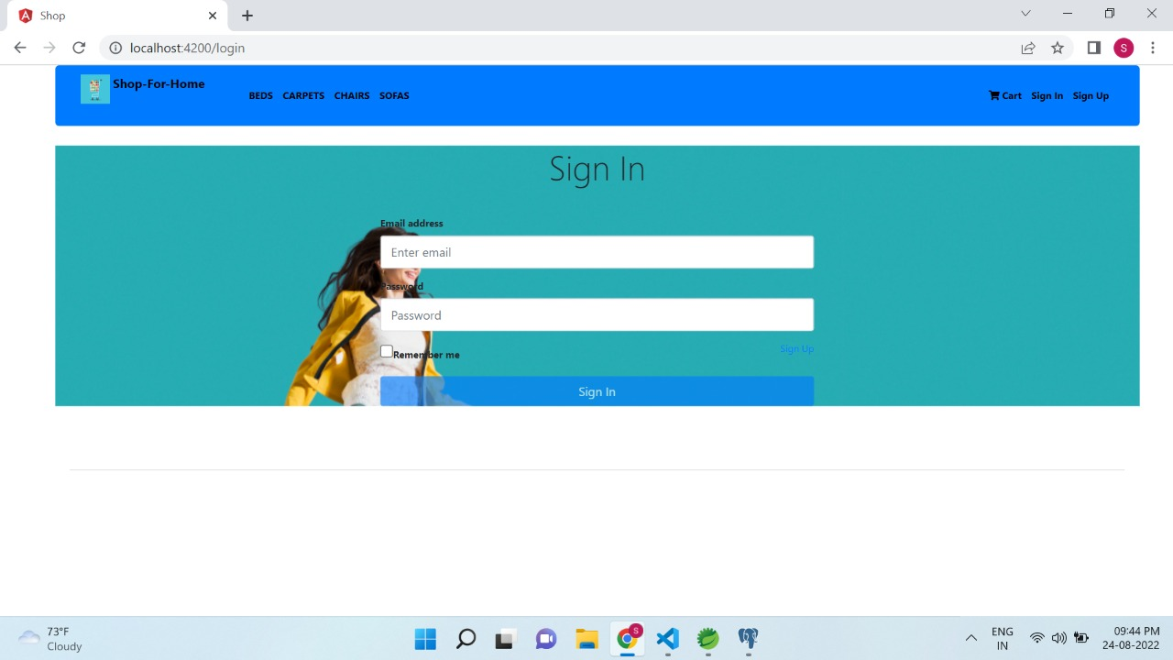
Sign in

Slide 18
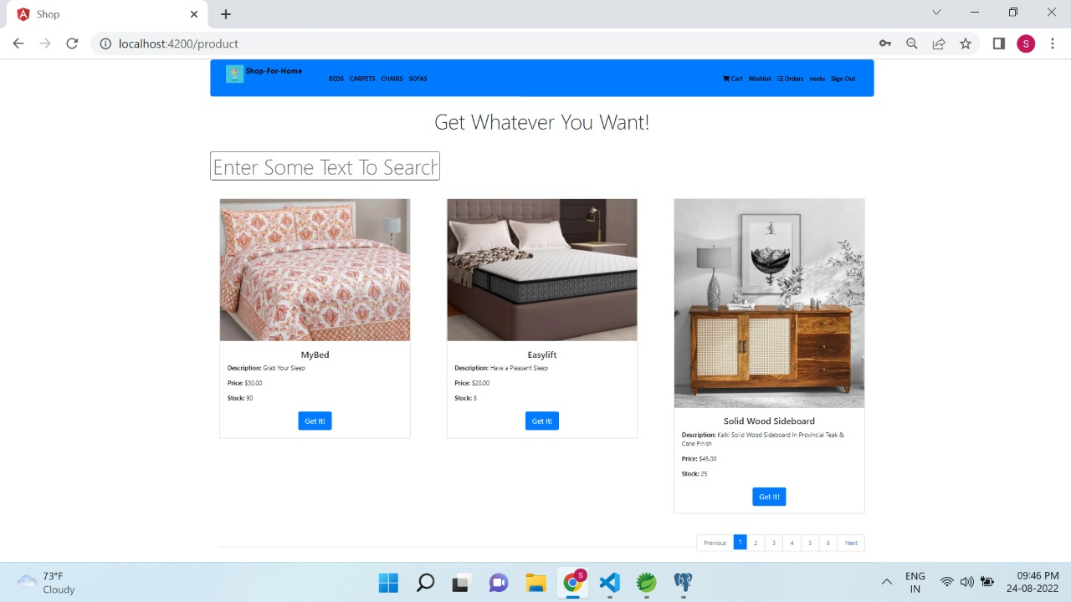
Home Page after login

Slide 19
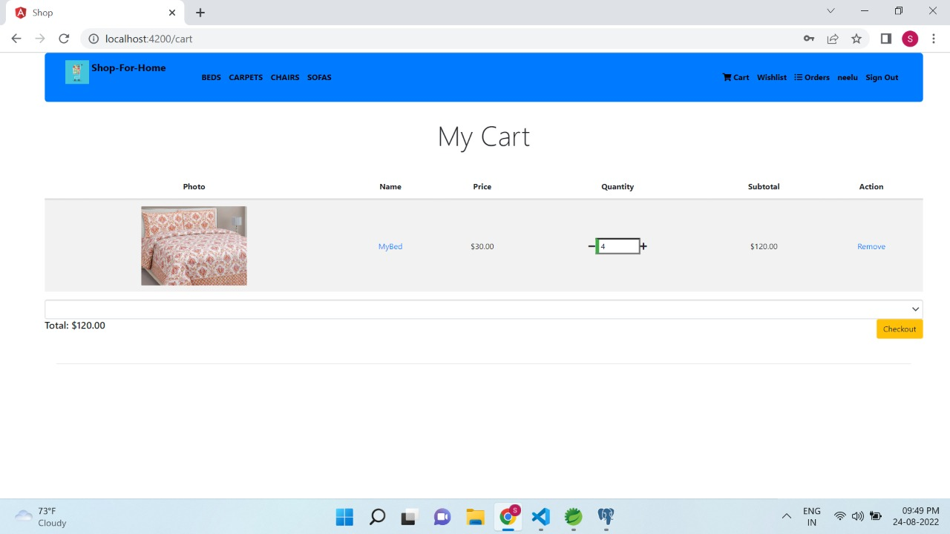
CART OPTION

Slide 20
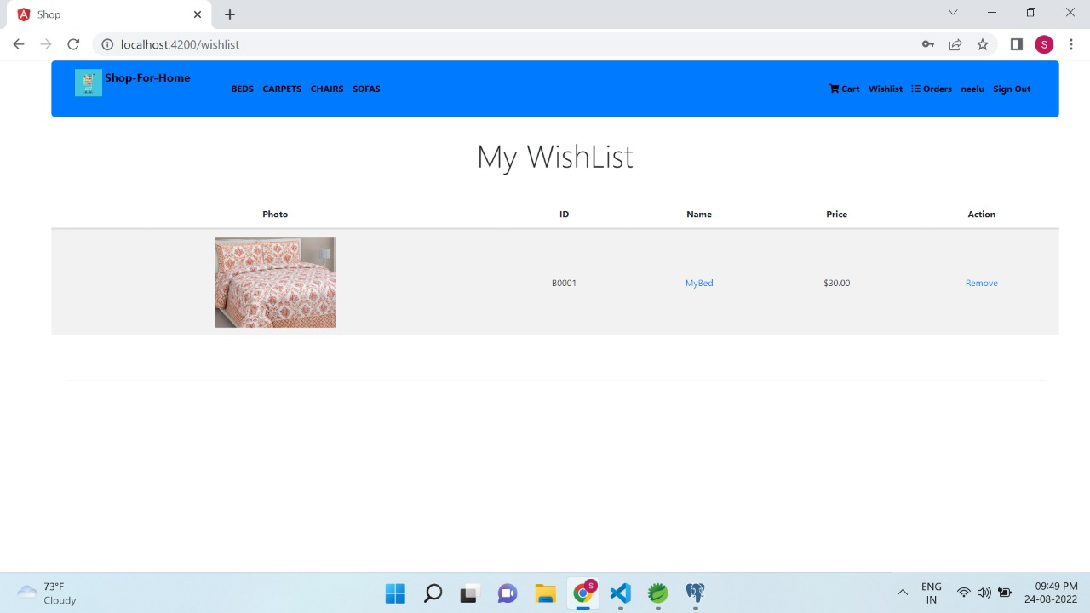
WISHLIST

Slide 21
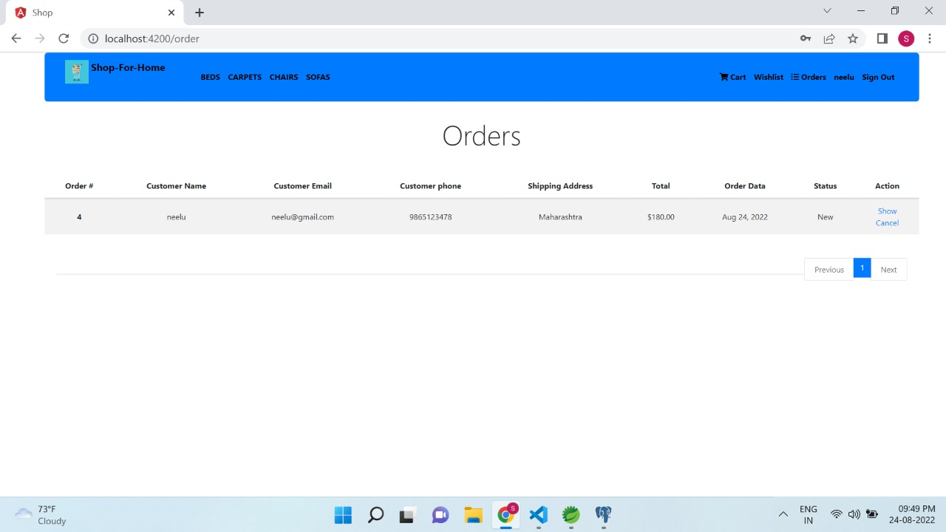
ORDERS INFO

Slide 22
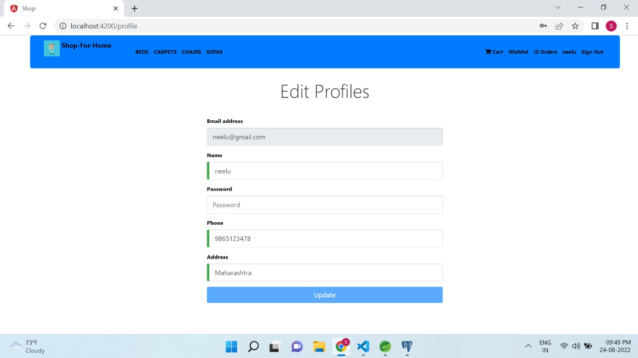
EDIT PROFILE

Slide 23
ADMIN ACTIONS
User Management
Products Management
Bulk upload
Download Sales Report
Generate Discounts

Slide 24
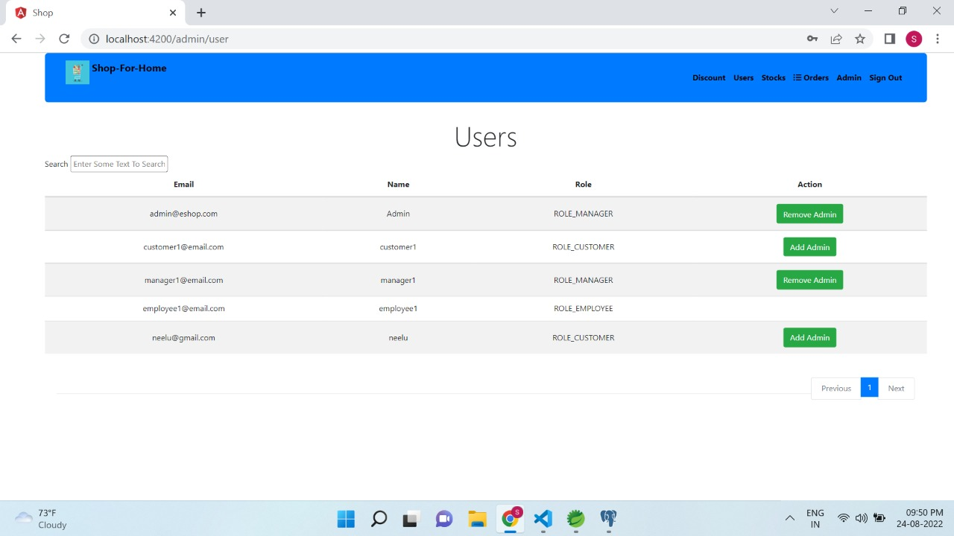
User Management

Slide 25
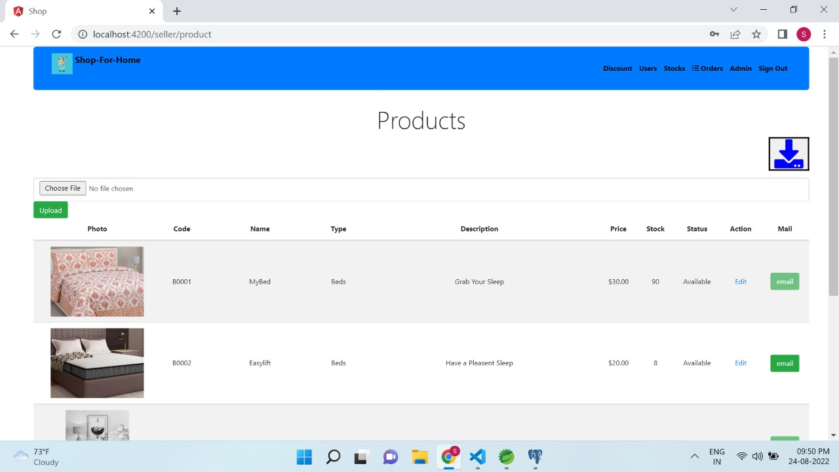
Products managements, bulk upload & download sales report

Slide 26
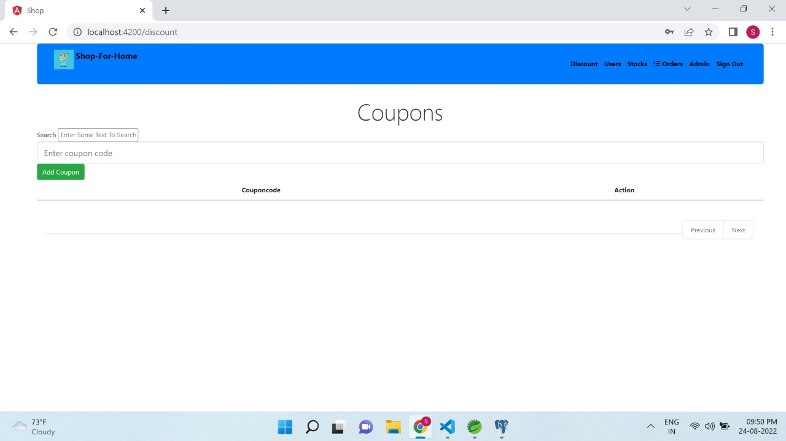
Generate discounts

Slide 27
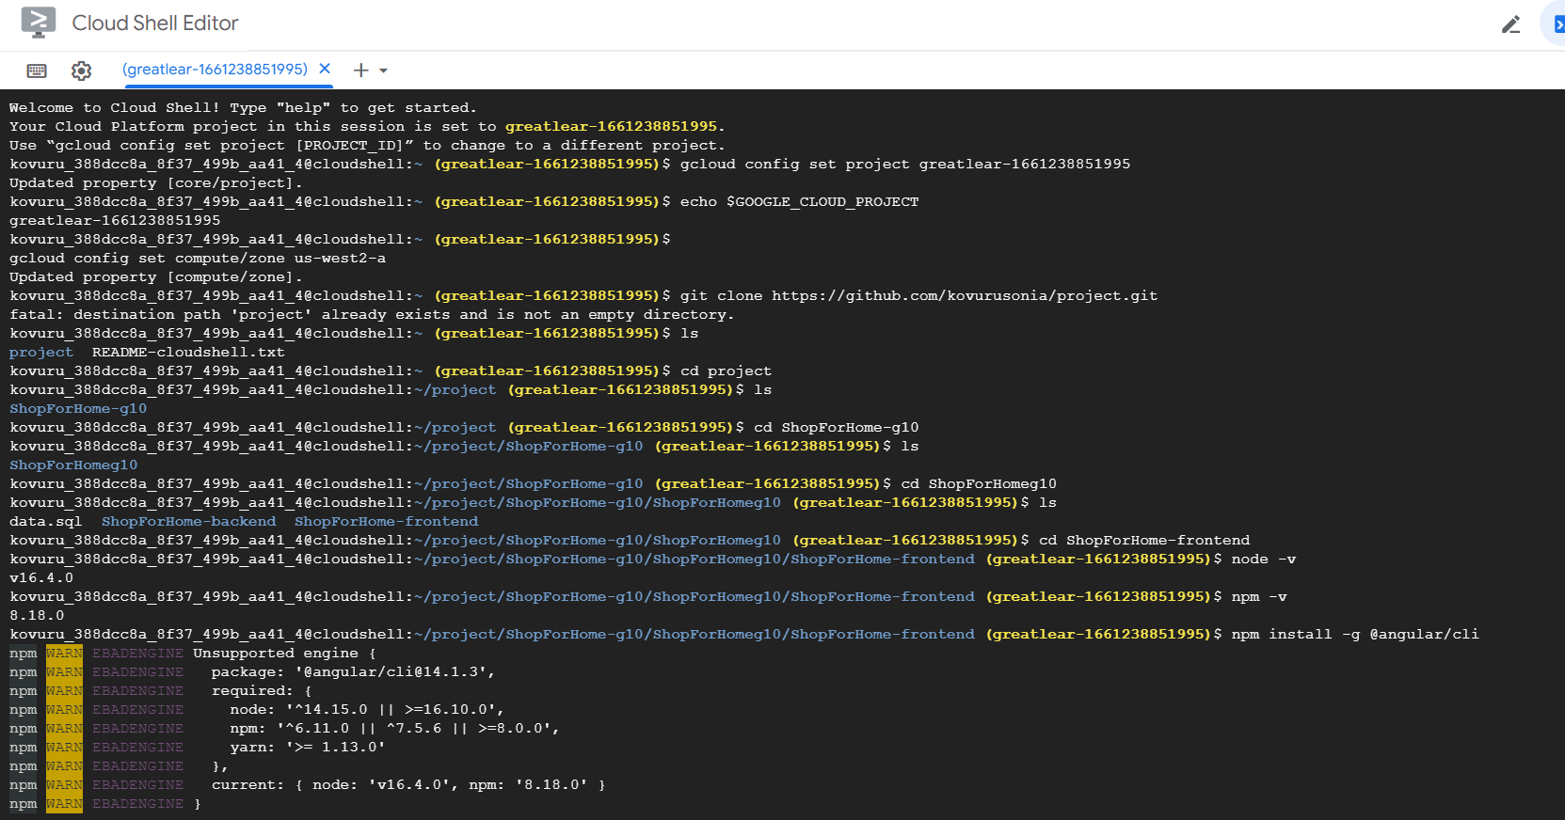
CLOUD DEPLOYMENT

Slide 28
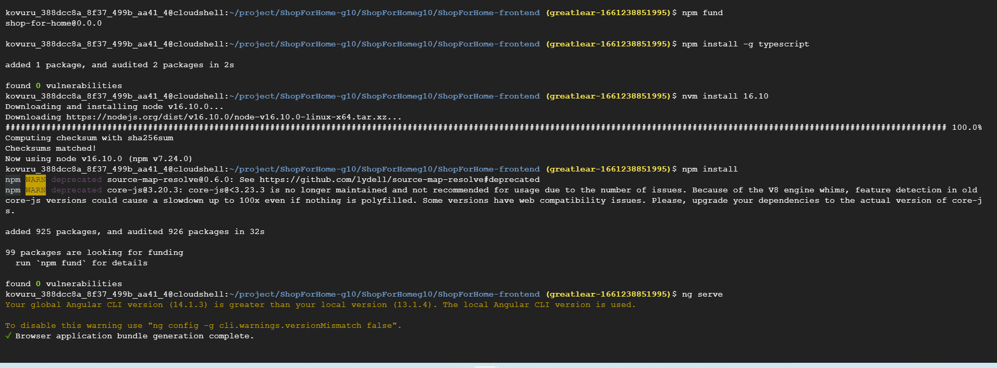
CLOUD DEPLYOMENT

Slide 29
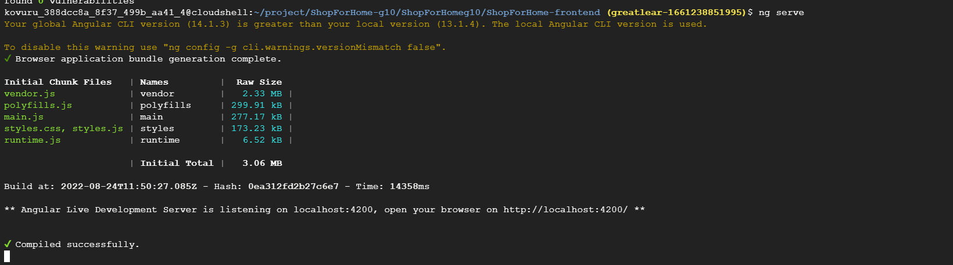
CLOUD DEPLOYMENT

Slide 30
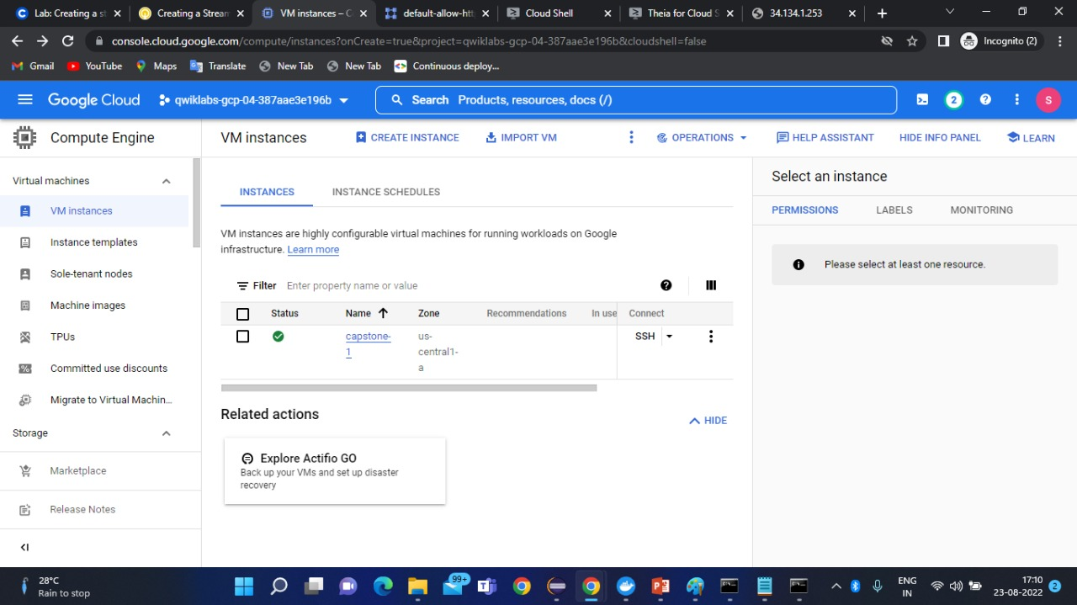
CLOUD DEPLYOMENT

Slide 31
conclusion
The system has been developed with much care and free of errors and at the same time it is efficient and less time consuming.
The purpose of this project was to develop a web application and an android application for purchasing items from a shop.
This project helped us in gaining valuable information and practical knowledge on several topics like designing web pages using html & css, usage of responsive templates, designing of android applications, and management of database using mysql .
The entire system is secured. Also the project helped us understanding about the development phases of a project and software development life cycle. We learned how to test different features of a project.

Slide 32
THANK YOU

